Slide 1

Backward Propagation Example
by
Prof. Diksha Arora
(Assistant Professor-CSE)
KIET Group of Institutions

Slide 2
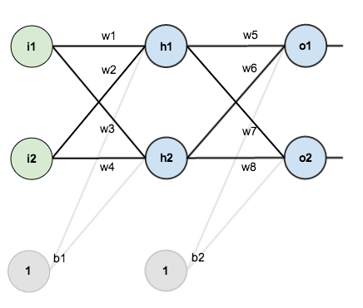
Neural Network with two inputs, two hidden neurons, two output neurons Additionally, the hidden and output neurons will include a bias.

Slide 3
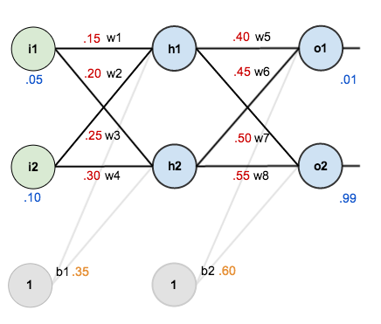
we’re going to work with a single training set: given inputs 0.05 and 0.10, we want the neural network to output 0.01 and 0.99.

Slide 4
The Forward Pass
To begin, lets see what the neural network currently predicts given the weights and biases and inputs of 0.05 and 0.10. To do this we’ll feed those inputs forward though the network.
We figure out the total net input to each hidden layer neuron, squash the total net input using an activation function, then repeat the process with the output layer neurons.

Slide 5
Here’s how we calculate the total net input for h1
We then squash it using the sigmoid function to get the output of h1
Carrying out the same process for h2 we get:

Slide 6
We repeat this process for the output layer neurons, using the output from the hidden layer neurons as inputs.
Here’s the output for o1:
And carrying out the same process for o2 we get:

Slide 7
Calculating the Total Error
We can now calculate the error for each output neuron using the squared error function and sum them to get the total error:
The1/2 is included so that exponent is cancelled when we differentiate later on. The result is eventually multiplied by a learning rate anyway so it doesn’t matter that we introduce a constant here

Slide 8
Back Propagation
The goal with backpropagation is to update each of the weights in the network so that they cause the predicted output to be closer to the target output, thereby minimizing the error for each output neuron and the network as a whole.

Slide 9
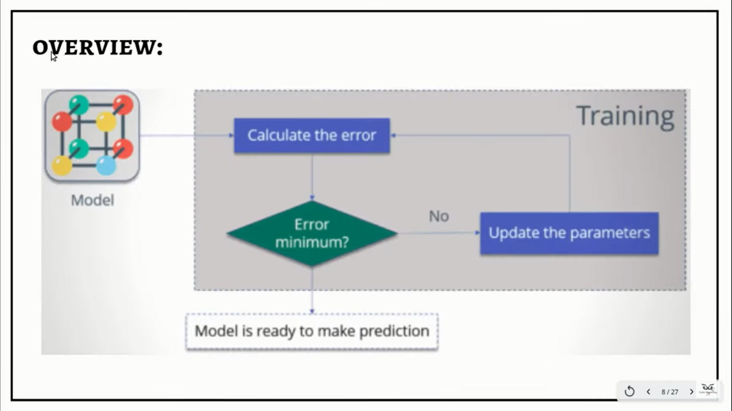
Back Propagation

Slide 10
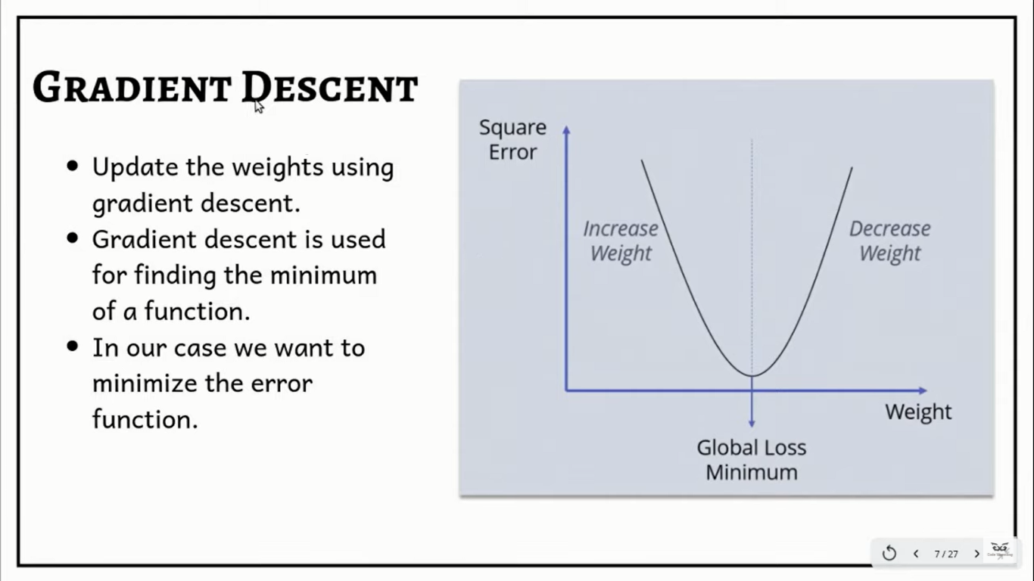
Gradient Descent
Gradient descent is an optimization algorithm used to find the values of parameters (coefficients) of a function (f) that minimizes a cost function (cost).
Update the weights using Gradient Descent.
Gradient Descent is used to find the minimum of a function.
In our case we want to minimize the error function.

Slide 11


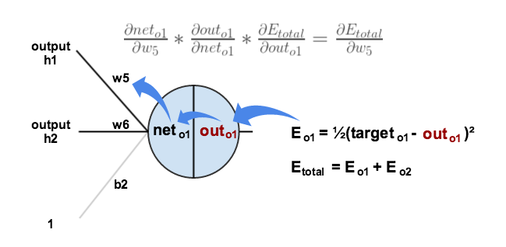
Output Layer
Consider w5. We want to know how much a change in w5 affects the total error, aka

Slide 13

The partial derivative of the logistic function is the output multiplied by 1 minus the output:
Finally, how much does the total net input of o1 change with respect to w5?

Slide 14

Putting all these together:
You’ll often see this calculation combined in the form of the delta rule:

Slide 15



To decrease the error, we then subtract this value from the current weight (optionally multiplied by some learning rate, which we’ll set to 0.5):
Repeating for w6, w7 and w8

Slide 16
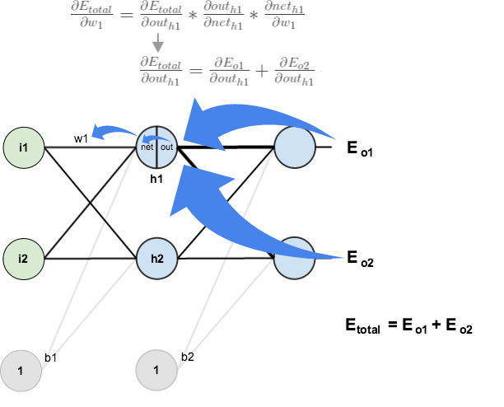

Hidden Layer
Next, we’ll continue the backwards pass by calculating new values for w1, w2, w3 and w4

Slide 17


We’re going to use a similar process as we did for the output layer, but slightly different to account for the fact that the output of each hidden layer neuron contributes to the output (and therefore error) of multiple output neurons. We know that affects both and

Slide 18


Therefore

Slide 19





Now that we have
we need to figure out
and then
for each weight
We calculate the partial derivative of the total net input to h1 with respect to w1 the same as we did for the output neuron:

Slide 20
Putting it all together:
We can now update w1:

Slide 21



Repeating this for w2, w3, and w4

Slide 22
Finally, we’ve updated all of our weights! When we fed forward the 0.05 and 0.1 inputs originally, the error on the network was 0.298371109.
After this first round of backpropagation, the total error is now down to 0.291027924. It might not seem like much, but after repeating this process 10,000 times, for example, the error plummets to 0.0000351085. At this point, when we feed forward 0.05 and 0.1, the two outputs neurons generate 0.015912196 (vs 0.01 target) and 0.984065734 (vs 0.99 target).

Slide 23
THANK YOU

